Slide 1
AI-Powered Research Agent using IBM Granite & IBM Cloud Lite
CAPSTONE PROJECT
Presented By:
Name: Shruti Sudhir Shimpi
College: Pimpri Chinchwad College of Engineering
Department: Information Technology

Slide 2
OUTLINE
Problem Statement (Should not include solution)
Proposed System/Solution
System Development Approach (Technology Used)
Algorithm & Deployment
Result (Output Image)
Conclusion
Future Scope
References

Slide 3
Problem Statement
In academic and industrial research, gathering relevant literature, summarizing papers, managing references, and drafting reports are time-consuming and repetitive tasks. Researchers often struggle with the overwhelming volume of publications and lack of centralized tools to automate the research workflow. There is a need for an intelligent system that can assist researchers by automating these tasks and enhancing the efficiency and quality of research

Slide 4
Proposed Solution
The proposed system is an AI-powered Research Agent designed to assist researchers by automating various stages of the research process. This agent will:
Understand user-input research questions using natural language processing.
Search and retrieve relevant academic papers from open-access repositories.
Summarize the content of these papers using large language models.
Manage and format citations in standard formats like APA or BibTeX.
Draft components of a research paper (e.g., abstract, literature review).
Generate downloadable reports including summaries and references.
This intelligent agent is integrated with IBM Cloud Lite services and powered by IBM Granite foundation models to ensure a scalable and efficient solution

Slide 5
System Approach
Component | Technology/Tool Used
Natural Language Processing | IBM Granite Foundation Model
Backend Development | Python (Flask)
Frontend (UI) | HTML, CSS, JS (Optional)
Paper Retrieval | arXiv API / Semantic Scholar API
Citation Management | CrossRef API / Custom Formatter
Report Generation | Python-docx / ReportLab (PDF)
Cloud Deployment | IBM Cloud Foundry / IBM Code Engine
Data Storage | IBM Cloud Object Storage (Lite Tier)

Slide 6
Algorithm & Deployment
🔸 Main Workflow Algorithm
Input Parsing: Accept user query (e.g., “Recent trends in quantum computing”).
Keyword Extraction: IBM Granite LLM extracts keywords and intent.
Literature Search: Query academic APIs (arXiv/Semantic Scholar) with extracted terms.
Summarization: Fetch abstracts and use Granite LLM to generate concise summaries.
Citation Management: Extract and format metadata for each article.
Draft Generation: Based on summarized content, auto-generate literature review or abstract.
Report Compilation: Compile summaries and references into a downloadable document.
🔸 Deployment
Backend is containerized and deployed using IBM Cloud Foundry.
IBM Granite Foundation Model is invoked through API calls or integrated directly into the logic layer.
Data (PDFs, summaries, BibTeX files) is stored in IBM Cloud Object Storage.

Slide 7
Result
Present the results of the machine learning model in terms of its accuracy and effectiveness in predicting bike counts. Include visualizations and comparisons between predicted and actual counts to highlight the model's performance.

Slide 8
Conclusion
The Research Agent significantly improves research efficiency by automating literature review and citation tasks. Using IBM Granite's powerful NLP capabilities and IBM Cloud's deployment services, the system delivers accurate, quick, and organized results tailored to user queries. It minimizes manual effort, speeds up the research process, and offers a reliable tool for both academic and industry researchers.

Slide 9
Future scope
Discuss potential enhancements and expansions for the system. This could include incorporating additional data sources, optimizing the algorithm for better performance, and expanding the system to cover multiple cities or regions. Consider the integration of emerging technologies such as edge computing or advanced machine learning techniques.

Slide 10
References
IBM Granite Foundation Models Documentation – IBM Research
IBM Cloud Foundry Documentation – IBM Cloud Docs
arXiv API – https://arxiv.org/help/api
Semantic Scholar API – https://api.semanticscholar.org
CrossRef Citation API – https://www.crossref.org/
Python ReportLab Documentation – https://www.reportlab.com/docs/

Slide 11
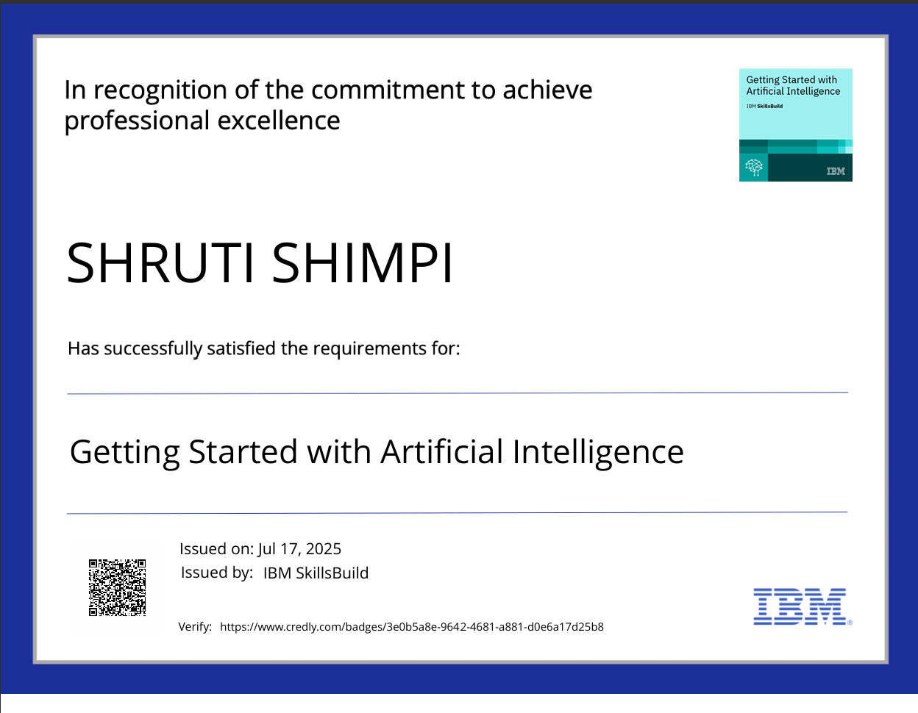
IBM Certifications

Slide 12
IBM Certifications
Screenshot/ credly certificate( Journey to Cloud)

Slide 13
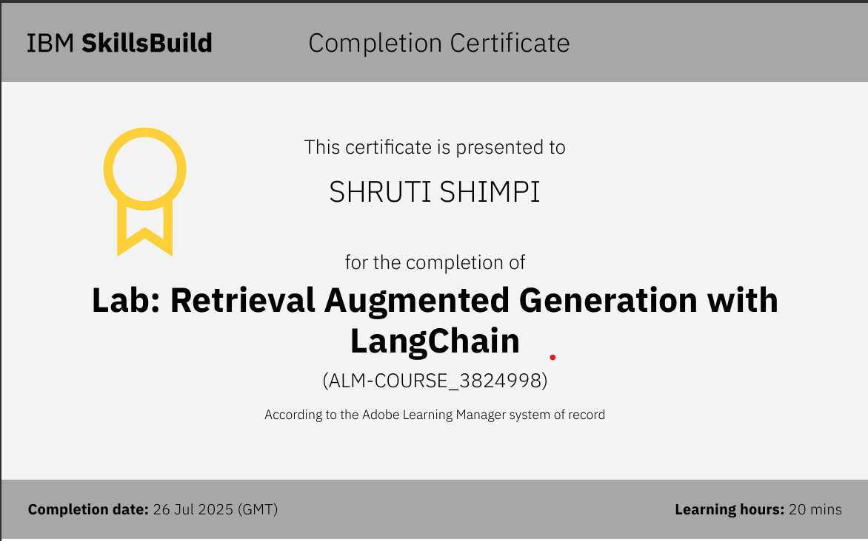
IBM Certifications

Slide 14
THANK YOU

